Slide 1
He Gave
John 3:16

Slide 3
John 3:16 For God so loved the world that he gave his one and only Son, that whoever believes in him shall not perish but have eternal life.

Slide 4
Genesis 12:1 The LORD had said to Abram, "Leave your country, your people and your father's household and go to the land I will show you.

Slide 5
² I will make you into a great nation and I will bless you; I will make your name great, and you will be a blessing.

Slide 6
³ I will bless those who bless you, and whoever curses you I will curse; and all peoples on earth will be blessed through you."

Slide 7
Genesis 15:2 "O Sovereign LORD, what can you give me since I remain childless and the one who will inherit my estate is Eliezer of Damascus?

Slide 8
³ You have given me no children; so a servant in my household will be my heir."

Slide 9
⁴ Then the word of the LORD came to him: "This man will not be your heir, but a son coming from your own body will be your heir."

Slide 10
⁵ He took him outside and said, "Look up at the heavens and count the stars--if indeed you can count them." Then he said to him, "So shall your offspring be."

Slide 11
⁶Abram believed the LORD, and he credited it to him as righteousness.

Slide 12
⁷ "I am the LORD, who brought you out of Ur of the Chaldeans to give you this land to take possession of it."

Slide 13
⁸ But Abram said, "O Sovereign LORD, how can I know that I will gain possession of it?"

Slide 14
⁹ The LORD said, "Bring me a heifer, a goat and a ram, each three years old, with a dove and a young pigeon."

Slide 15
¹⁰ Abram brought all these to him, cut them in two and arranged the halves opposite each other; the birds, however, he did not cut in half.

Slide 16
¹² As the sun was setting, Abram fell into a deep sleep, and a thick and dreadful darkness came over him.

Slide 17
¹⁷ When the sun had set and darkness had fallen, a smoking firepot with a blazing torch appeared and passed between the pieces.

Slide 18
¹⁸ On that day the LORD made a covenant with Abram and said, "To your descendants I give this land, from the river of Egypt to the great river, the Euphrates...

Slide 19
Genesis 17:1 When Abram was ninety-nine years old, the LORD appeared to him and said, "I am God Almighty; walk before me and be blameless.

Slide 20
² I will confirm my covenant between me and you and will greatly increase your numbers."
³Abram fell facedown...

Slide 21
Genesis 15:17 When the sun had set and darkness had fallen, a smoking firepot with a blazing torch appeared and passed between the pieces.

Slide 22
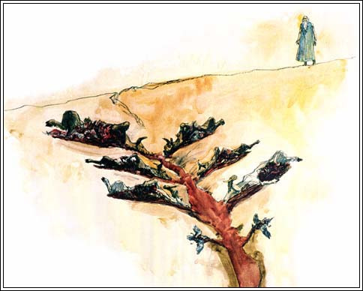

Slide 23
Hebrews 10:3 But instead, those sacrifices actually reminded them of their sins year after year.

Slide 24
⁴ For it is not possible for the blood of bulls and goats to take away sins.

Slide 25
Romans 3:22 This righteousness from God comes through faith in Jesus Christ to all who believe…

Slide 26
²³ for all have sinned and fall short of the glory of God…

Slide 27
²⁴ and are justified freely by his grace through the redemption that came by Christ Jesus.

Slide 28
²⁵ God presented him as a sacrifice of atonement, through faith in his blood. He did this to demonstrate his justice, because in his forbearance he had left the sins committed beforehand unpunished--

Slide 29
²⁶ he did it to demonstrate his justice at the present time, so as to be just and the one who justifies those who have faith in Jesus.

Slide 30
1 John 1:9 If we confess our sins He is faithful and just to forgive us our sins and cleanse us from all unrighteousness.

